Slide 1

Outland Adventures
Angela, Jacob, Skyler, Cameron, William
Charlie Group

Slide 2
Outland Adventures Case Study
Blythe Timmerson and Jim Ford have opened a type of traveling agency called Outland Adventures.
Providing gear, locations, and information, they will be allowing those who enjoy the outdoors to experience new places and adventures. They currently have 7 employees, including themselves.
They are looking to optimize their organization by tracking equipment sales, keeping up to date on popular locations, and inventory status.

Slide 3
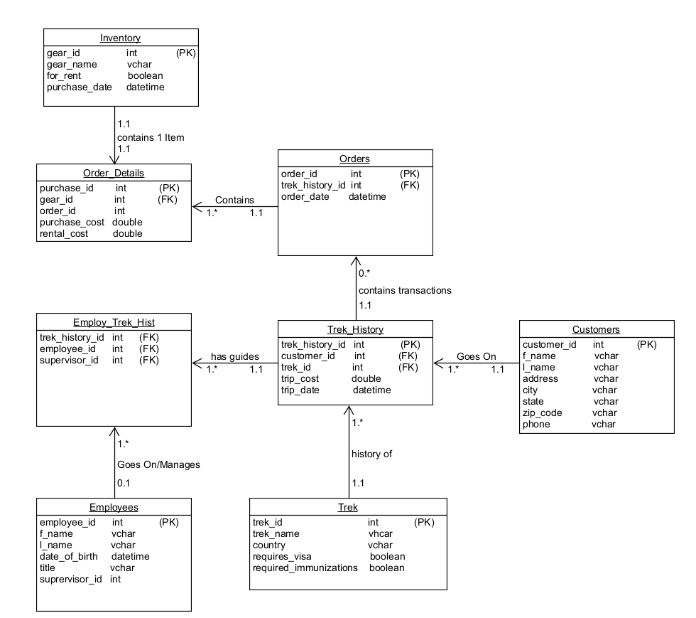
ORD
An ORD is an Objection-Relational Diagram.
Think of this as your road map to what is being captured and how it relates to each other. Through these relationships, we can create a plethora of queries and reports so Outland Adventures can make information business decisions.

Slide 4
Assumptions
A customer must have trek booked to rent or purchase gear
A customer can go on multiple treks
Multiple customers can go on a single trek
A trek will always have at least one guide
Not all employees have been on, or will supervise a trek
Not all customers will purchase gear, own gear is permitted

Slide 5
Business Rules
Every Customer goes on one to many treks, creating record in Trek_History
Every Trek_History contains zero to many Orders transactions
Every Trek_History record has one to many guides, recorded in Employ_Trek_Hist
Every Trek will have a history of one or many Trek_History records, number depends on the number of customers booking and the Trek and the Date of the Trek
Not every Employee will go on or manage treks, recorded in Employ_Trek_Hist; An employee can go on zero or many
Every Order contains one to many Order_Details depending on the number of items ordered.
Each Order Detail contains one item from Inventory

Slide 6
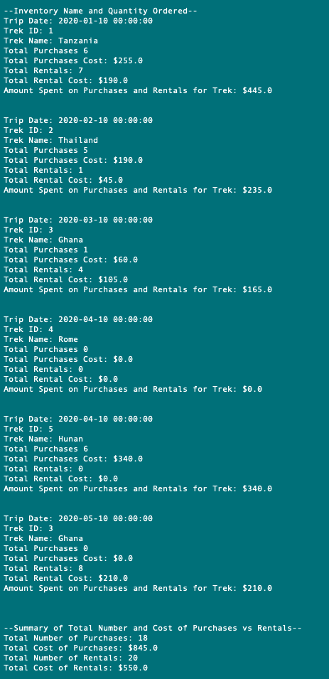

Purchases vs Rentals Per Trip Summary
Knowing whether customers are purchasing enough equipment or not is necessary information to keep your business running optimally. That’s why we created a report showing the sales and rentals of equipment as well as the overall summary of the two.

Slide 7
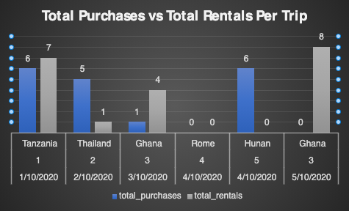
Purchases vs Rentals Per Trip Summary
As you can see in the graph created from the query results, Tanzania had exceptionally high purchases and rentals, and there appears in be a trend with several treks that followed of lower sales and rentals. Purchases did improve greatly in April on the Hunan track, and rentals in May on the Ghana track, however, neither yielded strong results in both categories.

Slide 8
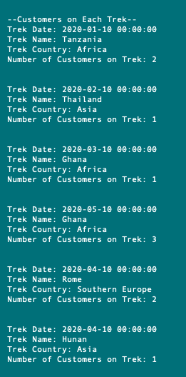
Customers Per Trek
In order to actively attract travelers and hikers, Outland Adventures will need to know which Treks are popular and which are falling off. By creating a report that shows this information will allow them to view customer trends, allowing adjustments as needed.

Slide 9
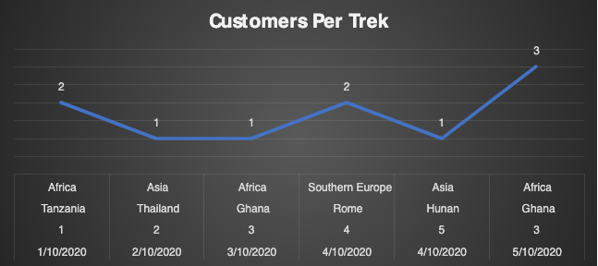
Customers Per Trek
Reviewing the trends with customers per trek, we can see that Africa was a consistently popular group choice with two customers in January and three in May. Asia seems to be primarily a solo destination with only single customers in the treks in February and April. Outland Adventures may consider seeking alternatives to Asia for its treks as single customer treks are unlikely to be profitable.

Slide 10
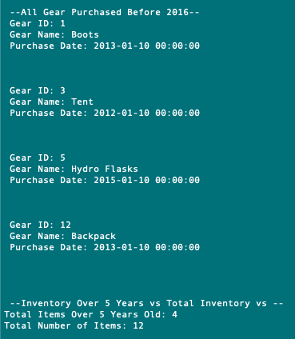
Gear over five years
Faulty equipment is always a liability, so having older gear can be concerning. This report will allow Outland Adventures to find the age of their gear and buy accordingly.

Slide 11
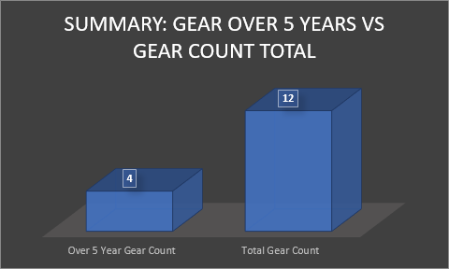
Gear over five years
Immediately we can see that there are twelve items currently in inventory with four of those items being more than five years old. In addition to safety, Outland Adventures will need to consider the costs of replacing 25% of its current inventory.

Slide 12
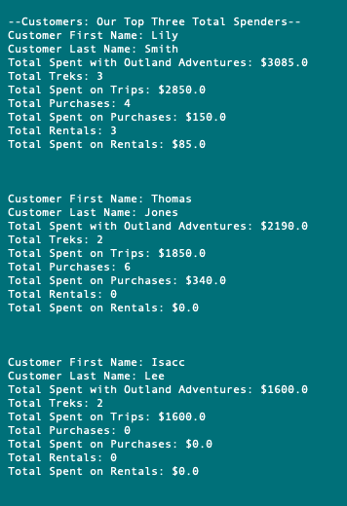
Top Spenders
Every business wants to reward its best customers, and the only way to do that is by knowing exactly who they are. With this report, Outland Adventures will be able to find the top 3 spenders and will be able to react accordingly.

Slide 13

Top Spenders
As mentioned, with information on top spenders Outland Adventures can certainly ensured they are treated like royalty on their upcoming treks. Additionally, this information also gives them an opportunity to get specific customer feedback so they can improve their trek and product offerings to make better memories and bigger spenders out of their entire customer base.

Slide 14

Conclusion
It is a pleasure to work with Outland Adventures. We believe by creating a thoughtful, and thorough, database system we have given the Outland Adventures the competitive advantage of knowledge. With the information Outland Adventures is capturing now they will be able to identify trends so they can make intelligent business decisions. Should Outland Adventure have any questions, concerns, or want to further discuss the possibilities of what we can offer, we’ll be there for the trek, after all, it’s dangerous to go alone!

